Slide 1
Sandwell Academy
Year 7 Information Evening
22 January 2019

Slide 2
Purpose of the Evening:
Introduce the online curriculum and key pages on the school website
Mychildatschool – MCAS
House points / rewards
Target Setting and the Module report system
IT Security- keeping your child safe

Slide 3
By now you should have:
Met with your child’s PT
Seen and returned Module One, Two and Three reports
Seen their homework planner and signed it
Been given MCAS login details and signed in
Students:
Will have received House points
May have been PT Star Student
Will have used the online curriculum

Slide 4
Online Curriculum

Slide 7
MCAS
mychildatschool.com

Slide 8
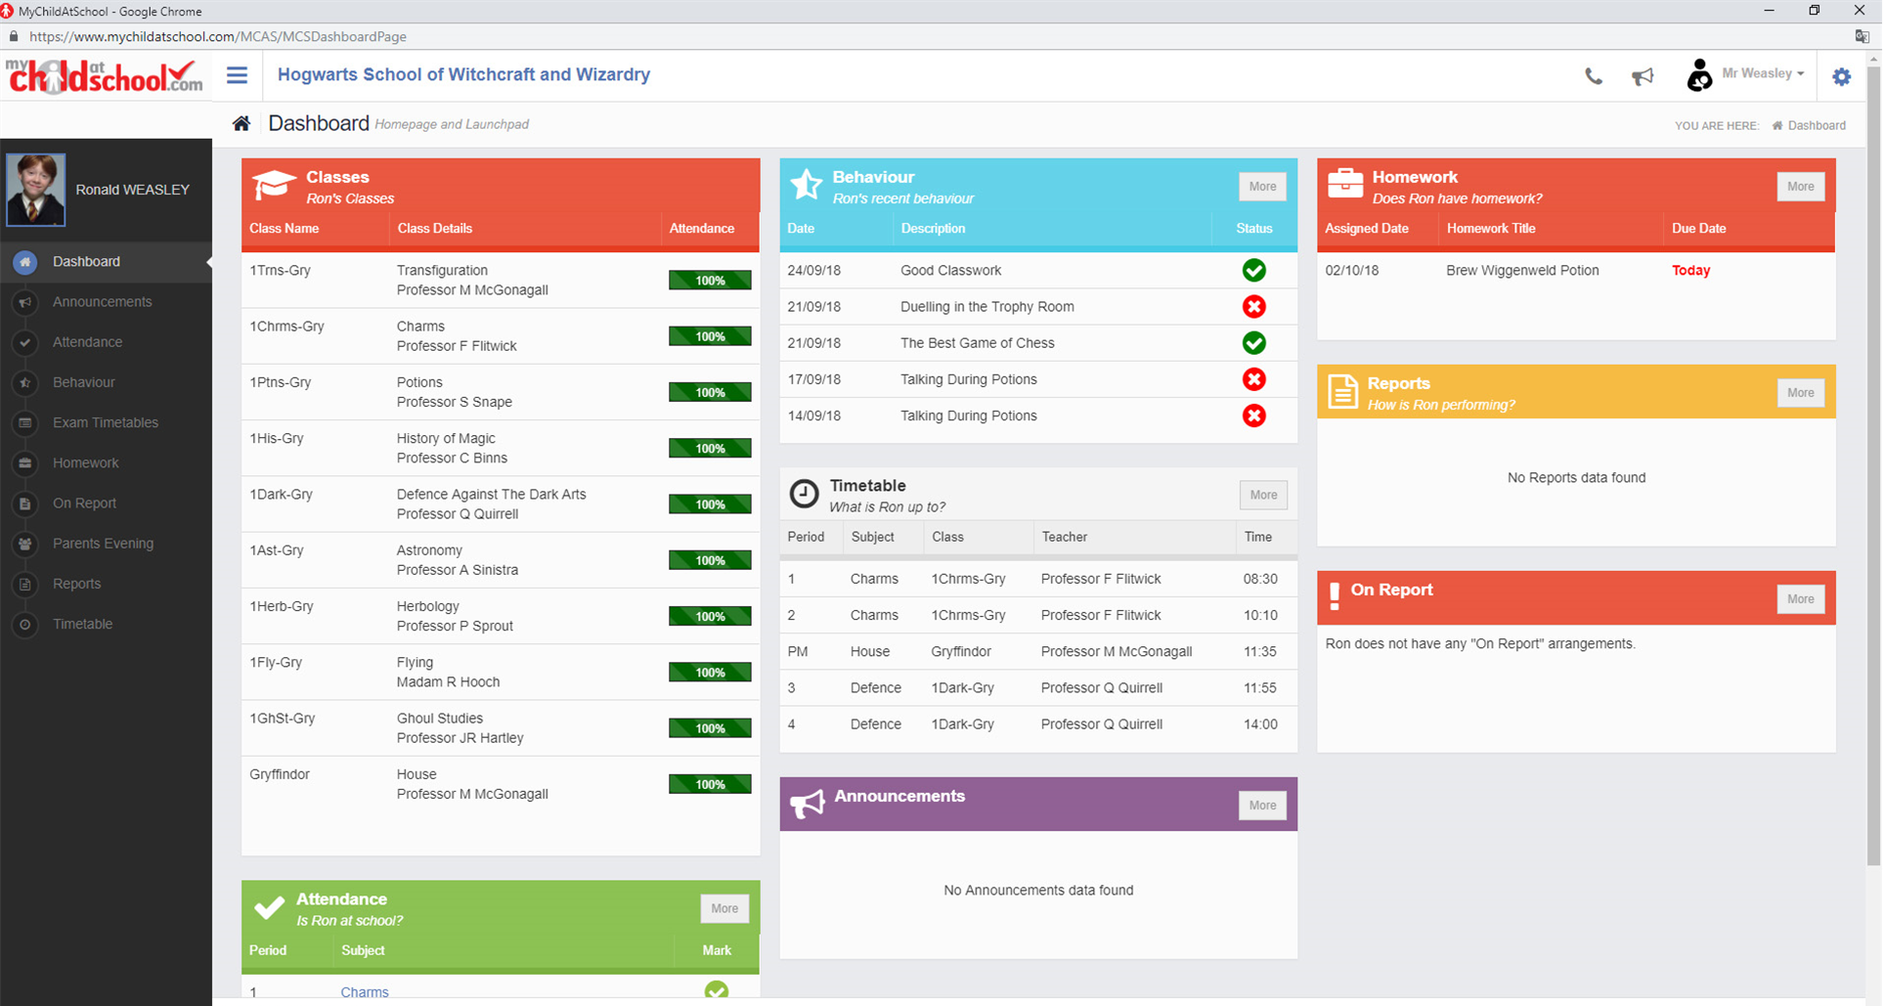

Slide 9
What is the Reward System

Slide 10
Target Setting
Students arrive at Sandwell Academy with scaled scores in reading, grammar and mathematics.
We are also told whether they have met or not met the expected standard (100) in each area.
English targets are set from the average scaled score for reading and grammar.
Maths targets are set from the mathematics scaled score.
All other subjects are set from the average of reading and mathematics.

Slide 11
Target Setting
Using scaled scores we calculate where students should be at the end of year 11 for all subjects.
We then work backwards assuming a student will make 0.8 levels of progress per year to get end of year target scores. 0.8 levels of progress is a challenging but achievable expectation.
End of year targets are guides.
If a student is working above there targets they will have an extra degree of challenge added.
If a student is struggling to meet targets support will be put in place.
Scaled Score | End Yr 7 | End Yr 8 | End Yr 9 | End Yr 10 | End Yr 11
110 (AS) | 2.8 | 3.6 | 4.4 | 5.2 | 6

Slide 12
Target Setting
Moving Forward
Recently moved to a new MIS system which has allowed us the opportunity to change how we report to parents.
The schedule remains the same across the year but the nature and presentation of reports has changed.
Feedback and comment on the reports is welcome.
The end result will be:
High standard reports which are easily interpreted for student progress, strengths and weaknesses.

Slide 13
Module Reports explained

Slide 14
Working with the PT

Slide 15
Working with the PT

Slide 16
Internet Safety

Slide 17
Why is education on this important for Students?
99% of 12-15 year olds have regular access to the internet
74% of 5-15 year olds have their own PC or laptop
Only 39% of homes with the internet have a filtering software in place
81% of 14-16 years old access explicit sexual photos or footage from home computers
61% have a mobile that can access the internet
9 out of 10 phones are not restricted
80% used gaming sites
50% used Social Networking sites
90% had access in their bedrooms
25% have met someone offline
83% have taken a friend

Slide 18
The need for this presentation
Parents
Children
Bridging the gap of knowledge around the internet
The Gulf of Internet Knowledge
Notes:
Many children will know more about the internet than the parent, so the aim of this presentation is to provide an insight into how children use the internet, and bridge the gulf of knowledge between the child and the parent.

Slide 19
THE POWER OF TECHNOLOGY
Improves teaching and learning
Allows us to access material when and where we like
Can be used to create amazing things
Needs to be used responsibly

Slide 20
A Connected World
Notes:
Reddit
Snapchat

Slide 21
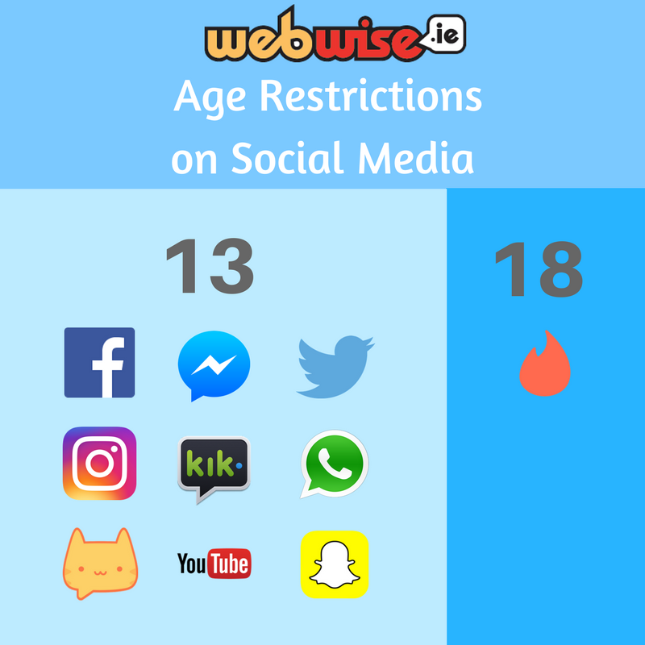
Ready for social networking?
PLAY
Notes:
Instagram- we may keep, use and share your personal information with companies connected to Instagram . This can include, name, emil address, school, likes, dislike, pictures we are not responsible what companies do with it.

Slide 22
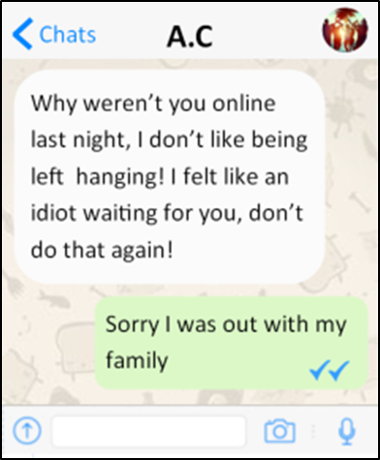
Online grooming
What it is:
Using the internet to manipulate and gain trust as a first step towards abuse
Always be alert to cyber strangers – they are not always easy to spot
Notes:
Ask yourself…

Slide 23
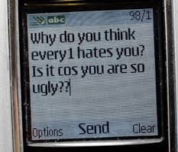
Cyber-bullying
What it is:
Use of the Internet and related technology to harm others
What to look for:
Texts or emails that you find hurtful
Posts on social networking sites
What to do:
Bullying of any kind is not tolerated at Sandwell Academy
Do not reply to bullying messages
Always report bullying
Nearly 43% of students nationally say they have been bullied online

Slide 24
Things to watch out for
Here are some common signs of grooming that you should be aware of. It doesn’t mean that your child is being groomed, but signs to look out for if you’re worried:
Excessive use of the computer
Aggressive behaviour regarding internet usage
Secretive behaviour
Change in use of sexual language

Slide 25
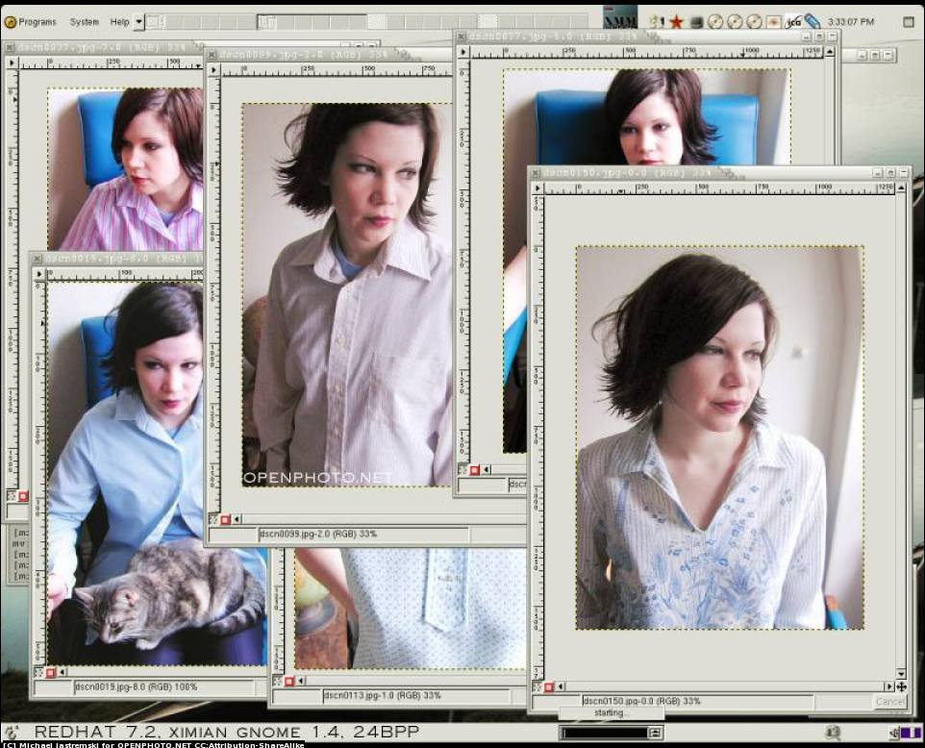
Identity theft
What it is:
When personal details are stolen and used fraudulently
By piecing together information about you from the internet, thieves can:
open bank accounts
make purchases
pretend to be you!
Notes:
Ask yourself…

Slide 26
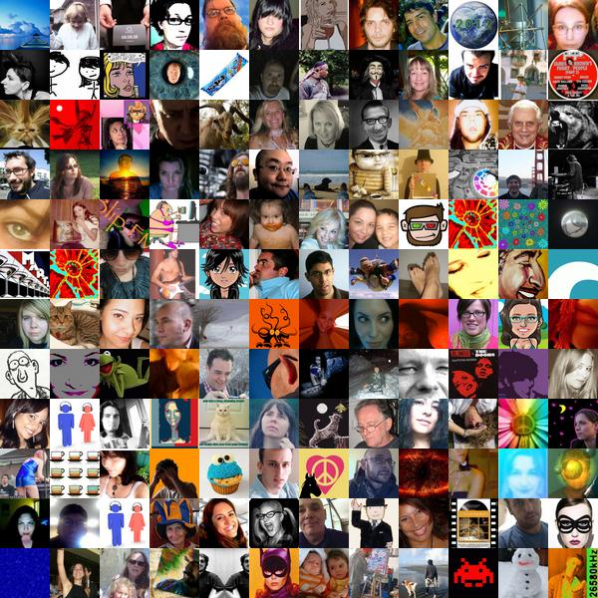
Would you put this on walls around Sandwell ?
Notes:
Information that non smart users put on the internet

Slide 27
Selfie & Live Streaming
A story?
Personal information
A message?
An invitation to contact or comment?
A challenge?
Creates an impression/
affects online reputation
Geotagging data
Reality or fantasy?

Slide 28
Sexting
When people talk about sexting, they usually refer to sending and receiving:
naked pictures or 'nudes'
'underwear shots'
sexual or ‘explicit pics'
rude text messages or videos
under 18, it is illegal to send a naked picture of yourself
If a recipient passes on the image, they could be breaking several civil laws. And if it’s done with negative intentions, it could even be classed as a criminal act.

Slide 29
3 Golden Rules
The internet is open to everyone – use it responsibly
If you are not 100% sure, don’t do it
Information is valuable – don’t give it away!
Keep your private information off the net
If you wouldn’t do it in real life – don’t do it online!
Enjoy the internet and be a smart user
Notes:
The internet is open to everyone – use it responsibly
If you are not 100% sure, don’t do it
Don’t download, accept/click yes/agree
Information is valuable – don’t give it away!
Keep you private information off the net
Be mysterious, post responsibly
If you wouldn’t do it in real life – don’t do it online!
Enjoy the internet and be a smart user
The internet is an amazing place and, like visiting a big city, if you stay aware it can a very enjoyable and rewarding experience.

Slide 30
Advice to Parents
Know what your children are doing online
Ask them to teach you to use any applications
Keep the computer in a family room - this means you can keep more control of what they do (i.e. Webcams)
When your child goes to bed at night remove any devices with internet capacity from their bedroom

Slide 31
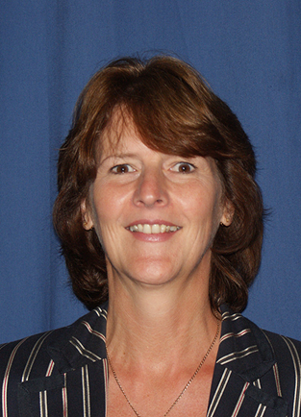
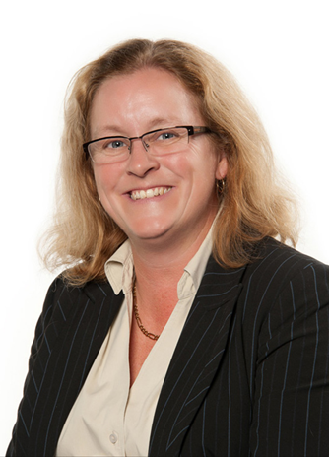
Safeguarding
Mrs Jones
Designated Safeguarding Lead
Mrs Povey
Deputy Designated Safeguarding Lead

Slide 32
Academy Website

Slide 34
www.childnet-int.org/kia/parents/

Slide 36
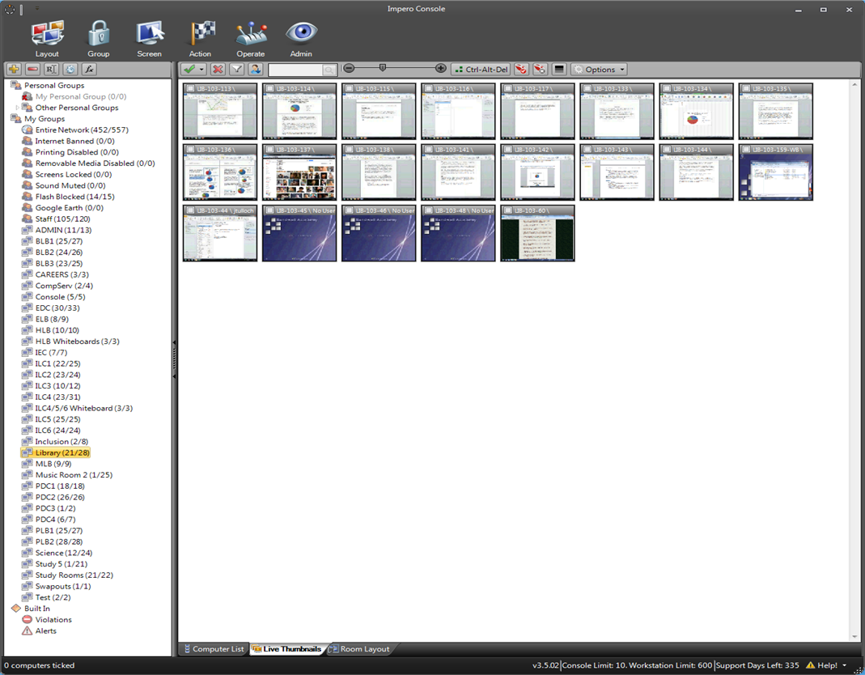

Slide 37
Sandwell Academy
http://www.cybersentinel.co.uk/
Forensics Software

Slide 38
Thank You For Listening
Mr Williams, Mr Mills, Mr Hull and Mrs Jones

